Slide 1
IBM APPLIED DATA SCIENCE CAPSTONE PROJECT: THE BATTLE OF NEIGHBORHOODS
CLUSTER ANALYSIS FOR REAL ESTATE IN LONDON (2018)

Slide 2
BUSINESS PROBLEM
In 2018 the London Housing Market was in a rut:
Brexit
Hidden price falls
Record-low sales
Homebuilder exodus
Tax hikes addressing overseas buyers of homes in England and Wales

Slide 3
BUSINESS PROBLEM
How could we have provided support to homebuyers clientele in purchasing a suitable real estate in London during this uncertain economic and financial scenario?

Slide 4
DATA AND METHODOLOGY
Data:
The data is sourced by merging data on London properties and the relative price paid data from the HM Land Registry, also data on amenities and essential facilities surrounding such properties are sourced from FourSquare API interface.

Slide 5
DATA AND METHODOLOGY
METHODOLOGY:
Collect Inspection Data;
Explore and Understand Data;
Data Preparation and Preprocessing;
Data Modeling

Slide 6
SOLUTION
By Clustering London neighborhoods in order to recommend venues and the current average price of real estate where homebuyers can make a real estate investment.

Slide 7
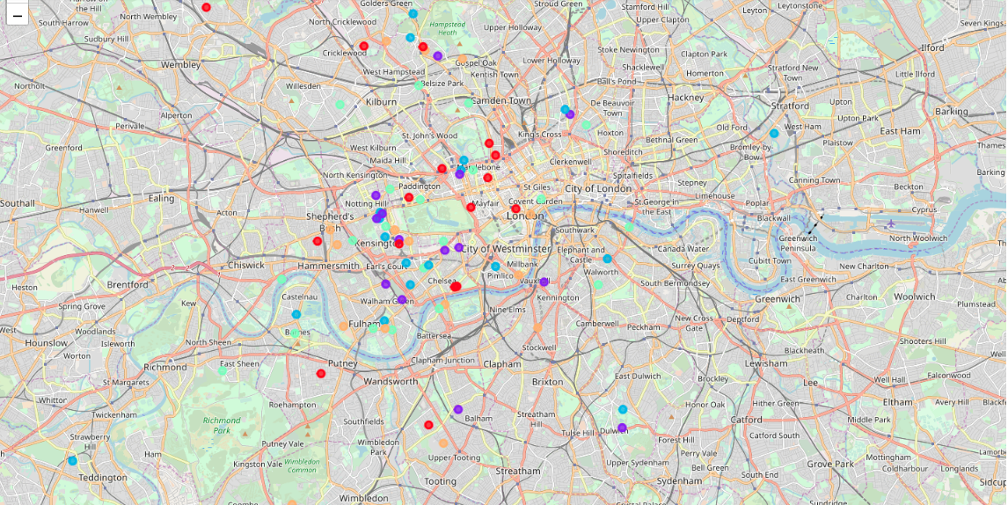
K-MEANS CLUSTERING

Slide 8
OUTCOME
Examination of real estates according to neighborhoods/London areas:
West London (Notting Hill, Kensington, Chelsea, Marylebone) and North-West London (Hampsted) might be considered highly profitable venues to purchase a real estate;
South-West London (Wandsworth, Balham) and North-West London (Isliington) are arising as next future elite venues with a wide range of amenities and facilities.

Slide 9
OUTCOME
Examination of real estates by clusters:
Clusters 0, 2 and 4 may target home buyers prone to live in 'green' areas with parks, waterfronts;
Clusters 1 and 3 may target individuals who love pubs, theatres and soccer.

